Slide 1
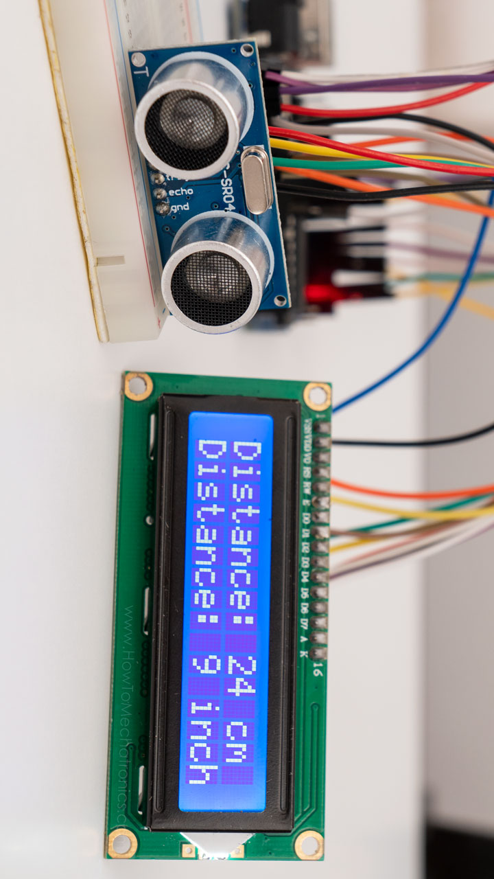
ULTRASONIC DISTANCE METER AND MOTING SENSING ALARM
Group 13

Slide 2
Abstract
The distance meter is used for accurately determining the distance of an object without contact by way of a laser.
The distance meter is attractive due to its ease of use and its high level of accuracy in the results recorded.
The distance meter can measure, store the readings to memory and determine the surface, the volume or height showing these on their display.
An Ultrasonic Distance Meter works on a principle of sound with a pitch too high for the human ear to hear.

Slide 3
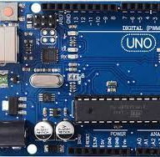
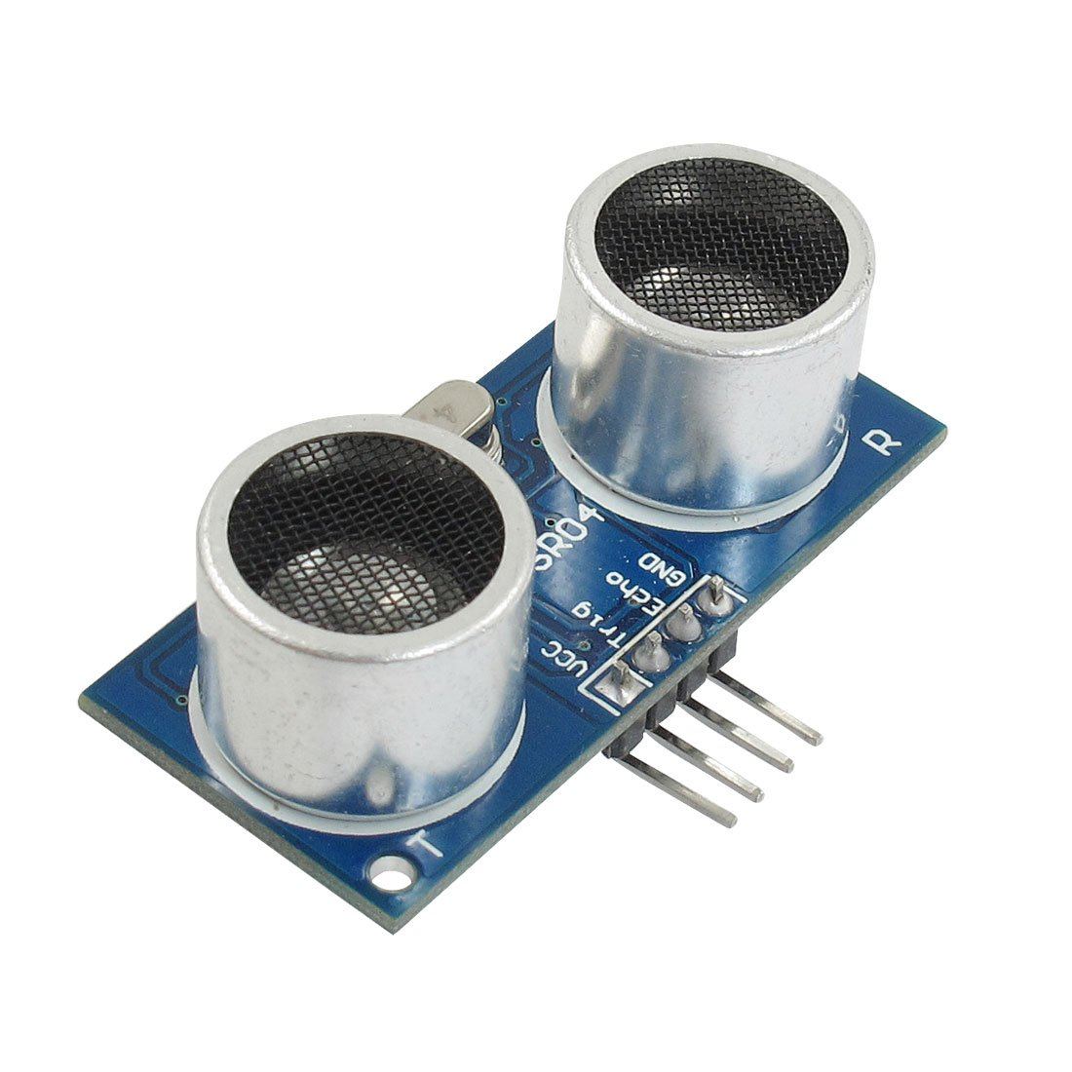
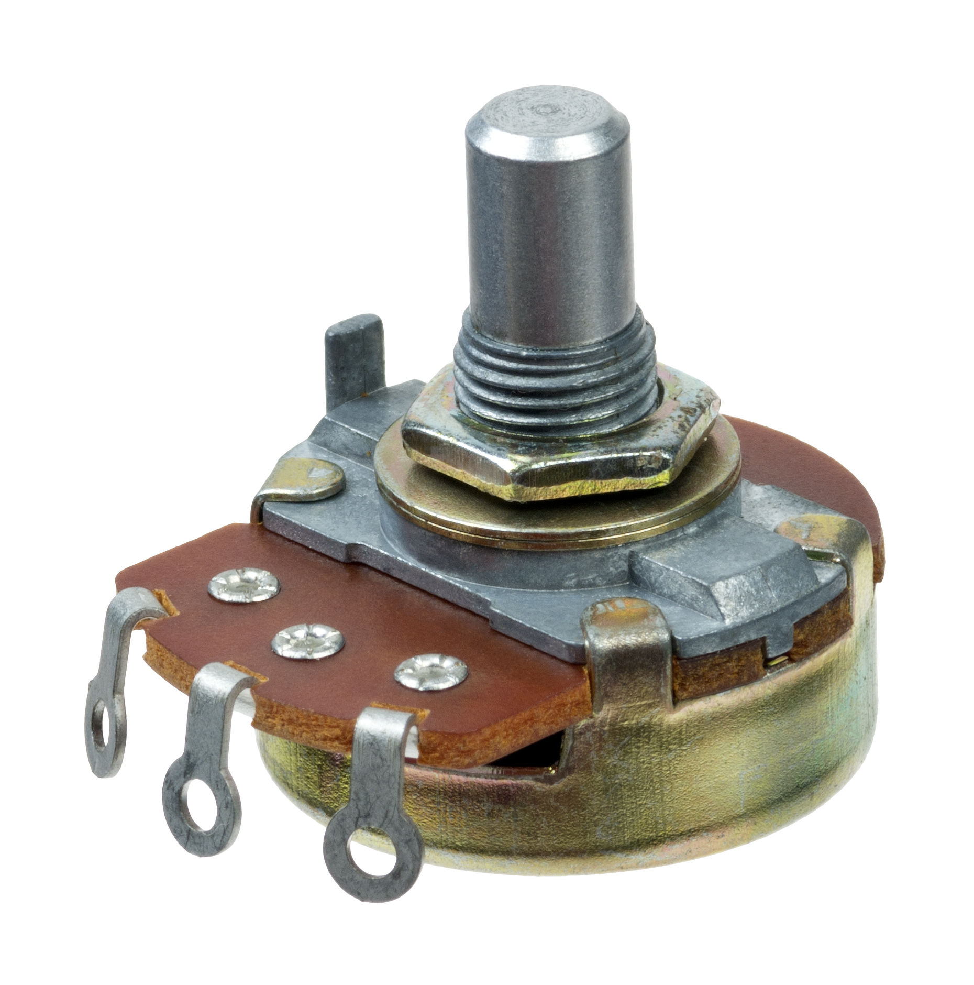
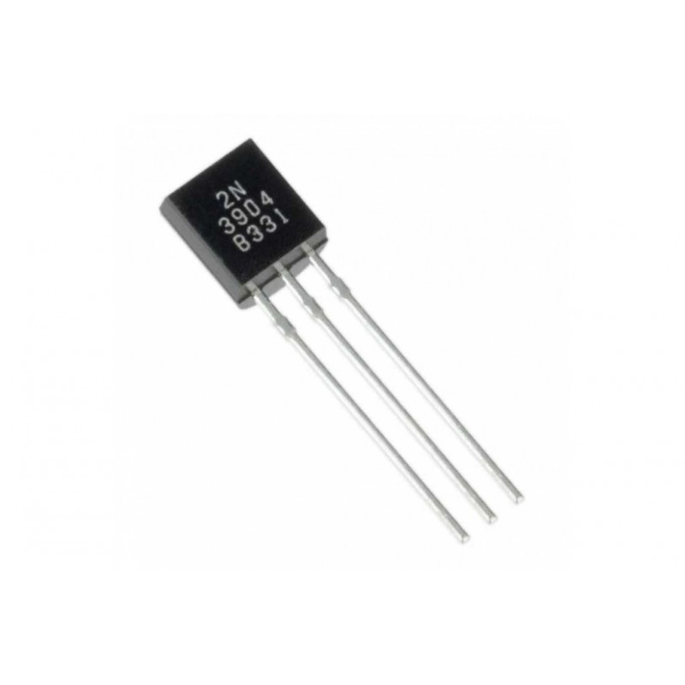
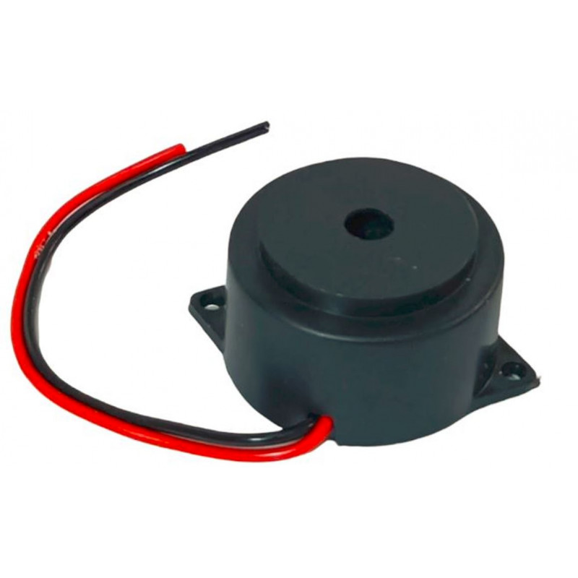
Parts Required
Arduino UNO
Arduino UNO is a microcontroller board based on the ATmega328P.
Ultrasonic sensor
An ultrasonic sensor is an instrument that measures the distance to an object using ultrasonic sound waves.
Arduino UNO
USB cable
The Arduino IDE installed on your PC
Set of Dupont cables
MB-102 breadboard
An HC-SR04 ultrasonic sensor
LCD 16x2 display
10k Ohm linear potentiometer
2N3904 transistor (or a 2N2222)
Number 2 10k Ohm resistor (1/4 Watt)
Push-button
Buzzer
Potentiometer
They are used to measure displacement in any direction.
Transistor
The 2N3904 is a common NPN bipolar junction transistor used for general-purpose low-power amplifying or switching applications.
Buzzer
A buzzer or beeper is an audio signaling device.

Slide 5

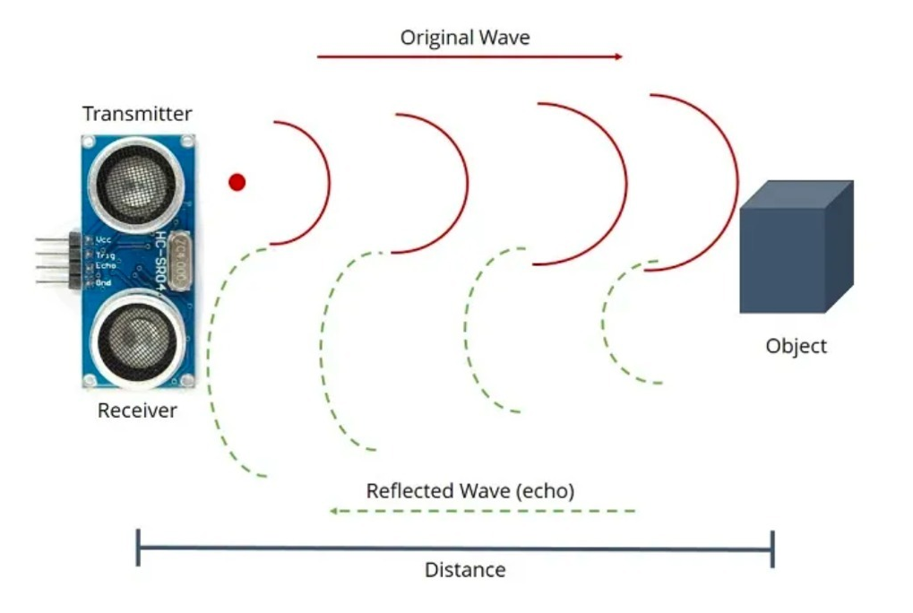
How are Ultrasonic Sensors used?
Ultrasonic distance, level, and proximity sensors are commonly used with microcontroller platforms like Raspberry Pi, ARM, PIC, Arduino, Beagle Board, and more.
Ultrasonic sensors transmit sound waves toward a target and will determine its distance by measuring the time it took for the reflected waves to return to the receiver.
This sensor is an electronic device that will measure the distance of a target by transmitting ultrasonic sound waves, and then will convert the reflected sound into an electrical signal.
An ultrasonic sensor can convert electrical energy into acoustic waves and vice versa.

Slide 6
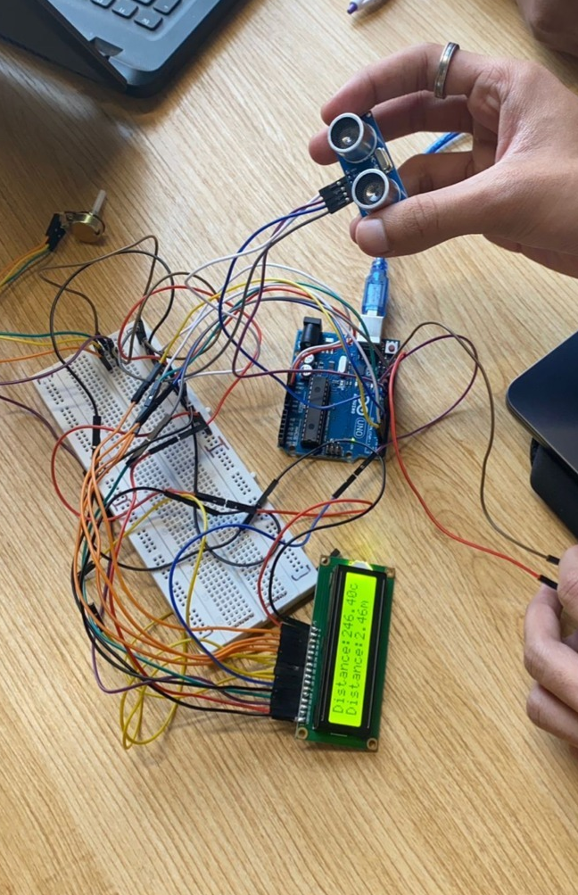
Working
Commonly associated with ultrasonic sensors, it functions by outputting a signal and measuring a change when the signal returns.
Distance sensors sense distance from the object and the measuring device through an output current.
The ultrasonic sensor emits high-frequency sound waves towards the target object, and a timer is started.
Target object reflects the sound waves back towards the sensor. The receiver picks up the reflected wave and stops the timer.
The time taken for the wave’s return is calculated against the speed of sound to determine the distance travelled.

Slide 7
Applications
car backing system
water level of the tank
fields like agriculture for scarecrow
detecting the depth of the snow
door alarm system for security purposes

Slide 8
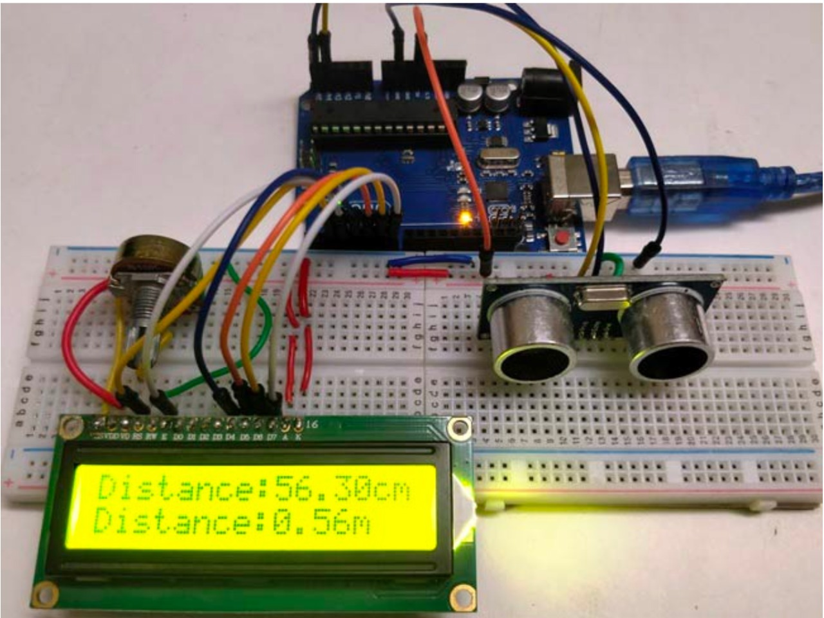
Result
The objective of the project was to design and implement an ultrasonic distance meter.
The device described here can detect the target and calculate the distance of the target.
The ultrasonic distance meter is a low cost, low a simple device for distance measurement.
The system after design and construction was tested and found to work in accordance with specifications
The Ultrasonic Distance meter can now also be used as a compact and cheap alternative for bigger devices of the same use.

Slide 9
References
[1] Dorp, P.V., & Groen, F.C.A. (2003), “Human walking estimation with radar,” IEEE Proceedings
on
Radar, Sonar and Navigation, Vo. 150(5), pp. 356-365.
[2] Ekimov, A., & Sabatier, J.M. (2006), “Broad frequency acoustic response of ground/floor to
human footsteps,” Proceedings of SPIE, Vol. 6241, OL-1-8.
[3] Ekimov, A., & Sabatier, J.M. (2006), “Vibration and sound signatures of human footsteps in
buildings,” Journal of Acoustical Society of America, 120(2), pp. 762-768.
[4] Geisheimer, J.L., Greneker, E., & Marshall, W.S. (2002), “A high-resolution Doppler model of
human gait,” Proceedings of SPIE, Vol. 4744, pp. 8-18.
[5] https://howtomechatronics.com/tutorials/arduino/ultrasonic-sensor-hc-sr04/
[6] https://www.viralsciencecreativity.co

Slide 10
Group Members
ISHITA JOHRI
20210802085
ISHIKA SINGH
20210802063
KHUSHI MUNDHADA
20210802176
RAGHAV NIMBALKAR
20210802036

